Slide 1
Molecular Biology Biol 480
Lecture 10 February 6th, 2019

Slide 2
Announcements/Assignments
Exam 1 –returned Friday.
Lab notebooks turned in Friday, Feb. 8th.
Labs 1,2,3
Lab quiz next week. Over Labs 1-4. Includes some questions on restriction mapping. (Work on the pGlO map and the concept).

Slide 3
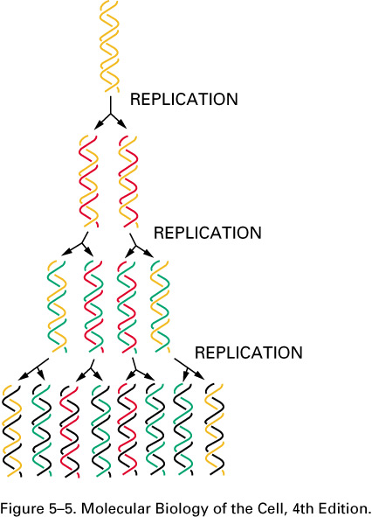
Where were we… Text chpt. 11
Starting DNA replication—experimental evidence for semiconservative replication

Slide 4
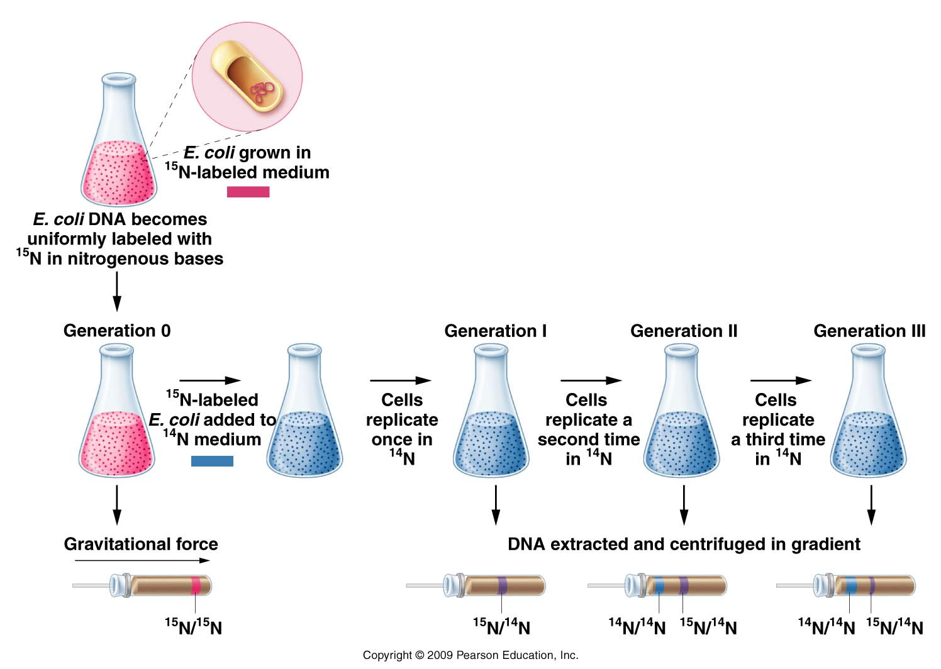
The Meselson-Stahl experiment
Figure 11.3
Notes:
Figure 11-3 The Meselson–Stahl experiment.

Slide 5
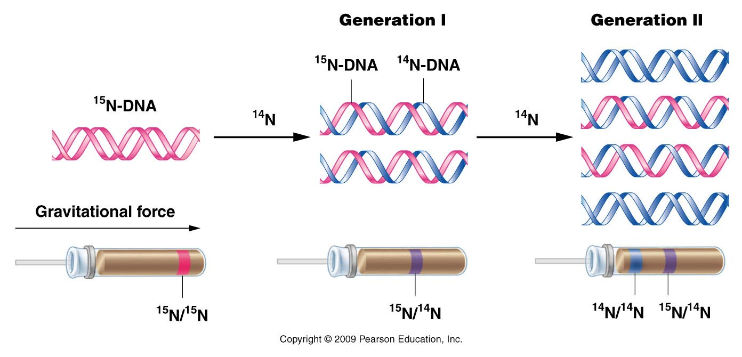
Figure 11.4
Notes:
Figure 11-4 The expected results of two generations of semiconservative replication in the Meselson–Stahl experiment.

Slide 6
Conclusion?
E. coli (and likely all bacteria) replicate their DNA via semiconservative mechanism.
What about Eukaryotes?

Slide 7
Taylor, Woods, Hughes experiment.
Used faba bean chromosomes and a more direct type of assay to test for semiconservative replication.

Slide 8
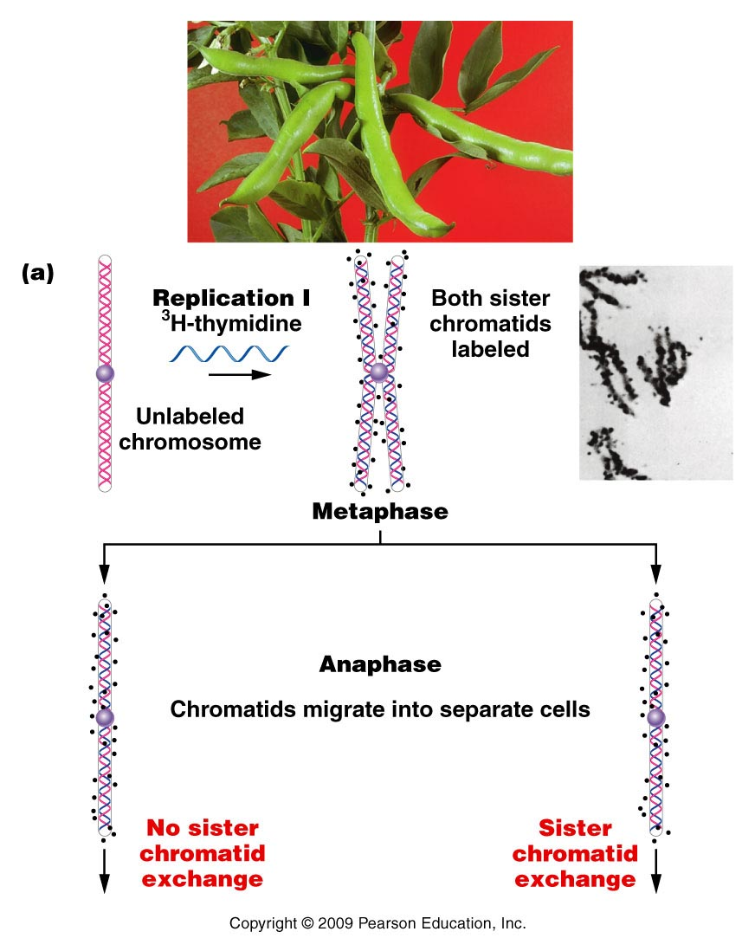
These experiments start with radioactive (“hot”) DNA ingredients
Dark grains indicate emission of radioactivity
Figure 11.5a
Notes:
Figure 11-5a The Taylor–Woods–Hughes experiment, demonstrating the semiconservative mode of replication of DNA in root tips of Vicia faba. A portion of the plant is shown in the top photograph. (a) An unlabeled chromosome proceeds through the cell cycle in the presence of 3H-thymidine. As it enters mitosis, both sister chromatids of the chromosome are labeled, as shown, by autoradiography. After a second round of replication (b), this time in the absence of 3H-thymidine, only one chromatid of each chromosome is expected to be surrounded by grains. Except where a reciprocal exchange has occurred between sister chromatids (c), the expectation was upheld. The micrographs are of the actual autoradiograms obtained in the experiment.

Slide 9
After one round of replication, if semiconservative replication occurs, one strand of each sister chromatid should be radioactive.
(Radioactivity in either/both strands is seen as dark spots)

Slide 10
When sister chromatids separate and get distributed to different cells in mitosis, those cells are allowed to replicate again, but in media that contains NO radioactive ingredients.

Slide 11
These experiments start with radioactive (“hot”) DNA ingredients
In each cell, if semiconservative replication took place only one strand of DNA is labeled.
Dark grains indicate emission of radioactivity
Figure 11.5a
Notes:
Figure 11-5a The Taylor–Woods–Hughes experiment, demonstrating the semiconservative mode of replication of DNA in root tips of Vicia faba. A portion of the plant is shown in the top photograph. (a) An unlabeled chromosome proceeds through the cell cycle in the presence of 3H-thymidine. As it enters mitosis, both sister chromatids of the chromosome are labeled, as shown, by autoradiography. After a second round of replication (b), this time in the absence of 3H-thymidine, only one chromatid of each chromosome is expected to be surrounded by grains. Except where a reciprocal exchange has occurred between sister chromatids (c), the expectation was upheld. The micrographs are of the actual autoradiograms obtained in the experiment.

Slide 12
Each chromosome is allowed to replicate a second time in unlabeled “cold” DNA ingredients. (only radioactive DNA from the first round will remain)
Figure 11.5b
Notes:
Figure 11-5b The Taylor–Woods–Hughes experiment, demonstrating the semiconservative mode of replication of DNA in root tips of Vicia faba. A portion of the plant is shown in the top photograph. (a) An unlabeled chromosome proceeds through the cell cycle in the presence of 3H-thymidine. As it enters mitosis, both sister chromatids of the chromosome are labeled, as shown, by autoradiography. After a second round of replication (b), this time in the absence of 3H-thymidine, only one chromatid of each chromosome is expected to be surrounded by grains. Except where a reciprocal exchange has occurred between sister chromatids (c), the expectation was upheld. The micrographs are of the actual autoradiograms obtained in the experiment.

Slide 13
Pulse-chase experiments
Use of isotopes and radiolabeling has been a great technique to follow the fate of biomolecules over time.
They are sometimes called “pulse-chase” experiments. The change in isotopes or change from radioactive (pulse) to non-radioactive (chase) shows where the the specific isotope goes.

Slide 14
Biochemical studies--
In 1957 Arthur Kornberg provided first evidence of a DNA replicating enzyme. Isolated it from E. coli—What would we do without E. coli?!
Called it DNA polymerase because it seemed to be able to link nucleotides to create a nucleotide polymer.

Slide 15
How did the enzyme work? Kornberg needed to provide:
Existing DNA molecule to copy (now called the template)
DNA building blocks---nucleotides
-tri-phosphate forms (dTTP, dATP, dCTP, dGTP) together, referred to as dNTPs.
N=any of the 4 deoxyribonucleotides.

Slide 16
Enzyme called DNA polymerase I---first one to be isolated. Now know that E. coli makes 5 different polymerases.
I
II
III
IV
V

Slide 17
Kornberg’s discovery…
Enzyme called DNA polymerase I---first one to be isolated. Now know that E. coli makes
I
II
III---actually the enzyme that does most of the DNA synthesis in E. coli
IV
V

Slide 18
DNA replication…
Kornberg’s DNA polymerase I (and all DNA polymerases) link nucleotides in a 5’ 3’ direction.
Nucleoside triphosphates (dNTPs) are hydrolzyed to nucleoside monophosphates (dMTPs) with the release of inorganic phosphate.

Slide 19
Nucleoside triphosphates provide energy in the phosphate bonds to create the new ester bond in the growing DNA strand.
You’ve known about ATP as an energy storage molecule in cells…in DNA synthesis all 4 triphosphate nucleosides provide energy

Slide 20
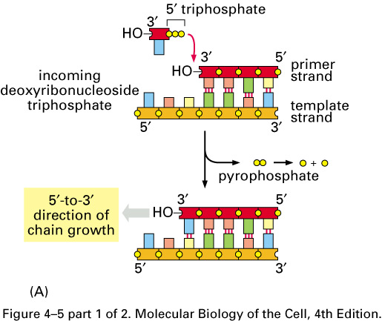

Slide 21
DNA “elongase”?
DNA polymerases can only extend existing stretch of DNA. Cannot start a new strand from scratch.
DNA polymerases require a nucleic acid “primer”.
In cells this primer is a short stretch of RNA (made by an RNA polymerase). In in vitro replication the primer can be RNA or DNA.

Slide 22
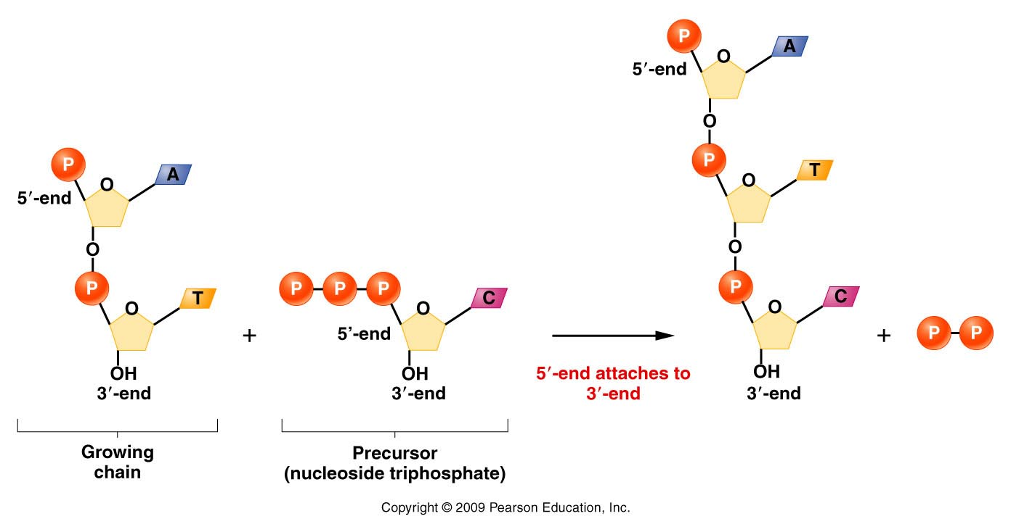
DNA polymerases require a free 3’0H group.
Figure 11.8
Notes:
22
Figure 11-8 Demonstration of 5’ to 3’ synthesis of DNA.

Slide 23
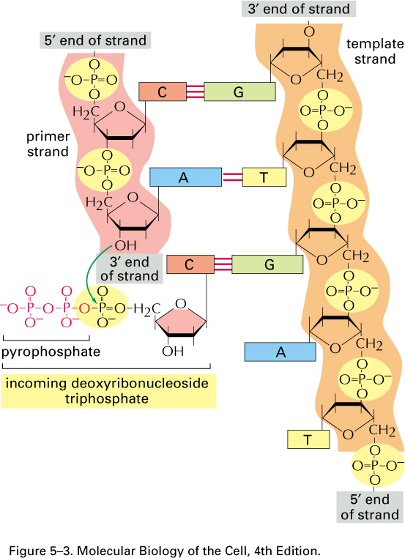

Slide 24
Where does a DNA molecule begin its replication?...
Specific regions of chromosome are recognized by proteins that help open the helix and expose each strand.
Region of the DNA is called:
Origin of replication [Ori] (in prokaryotes)
Autonomously replicating sequences (ARS) [in eukaryotes]

Slide 25
The Ori C is not a gene---it does not encode RNA or a protein, but the DNA sequence attracts specific initiator proteins, such as one called DnaA
The E. coli chromosome has a single OriC which is the site of initial DNA strand separation. This opening expands to form a replication bubble.

Slide 26
The Ori/ARS region is typically rich in A-T base pairs.
Why more A-T base pairs than G-C base pairs in these regions?

Slide 27
Features of origins/ARSes ;)

Slide 28
In bacteria, like E. coli, a single OriC attracts proteins called initiator proteins, which bind and disrupt H-bonding in the region.
The main initiator protein is named dnaA protein.

Slide 29
Let’s pause…
In biology it can get confusing as to whether you are reading a gene name or a protein name.
Why are some genes/and or proteins named using some capital letters, or some capital letters?
What do italics mean?
Check this out: http://www.biosciencewriters.com/Guidelines-for-Formatting-Gene-and-Protein-Names.aspx

Slide 30
An E. coli origin of replication
DnaA–initiator protein
DnaB/C-–origin helicase
Dna G—primase

Slide 31
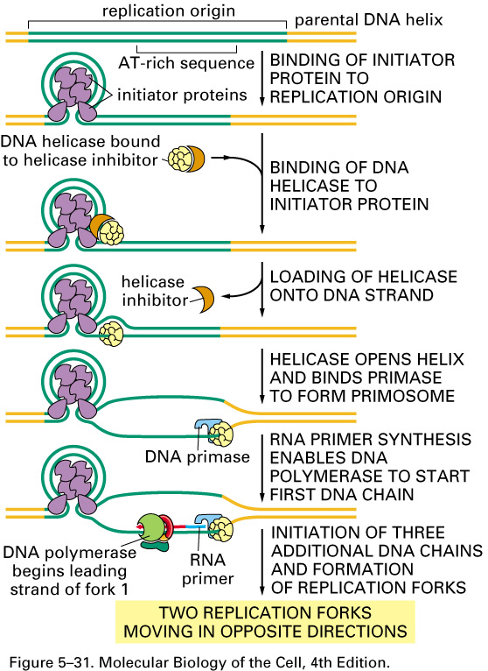

Slide 32
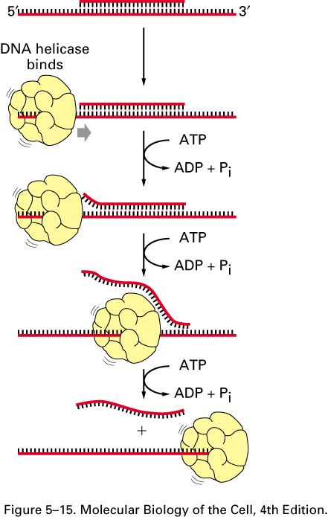
Initiator proteins break the first H-bonds between complementary bp within the origin and make space for a large enzyme complex called helicase.
Helicase is an ATP (energy) dependent enzyme that will continue to break the H-bonds and separate the complementary strands

Slide 33
Once helicase exposes some single template DNA strands, a protein called single-strand binding protein binds the ss template strand.
These proteins prevent complementary base interactions between the strands that are newly separated.

Slide 34
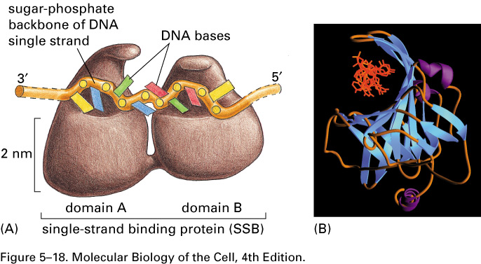

Slide 35
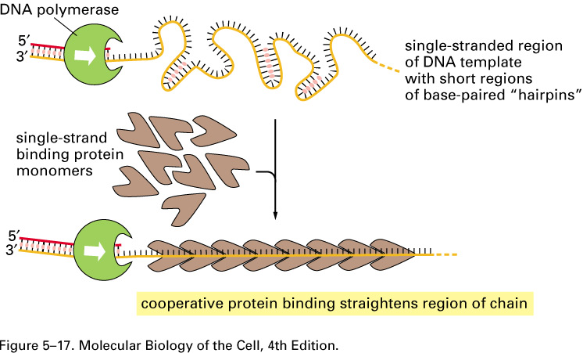

Slide 36
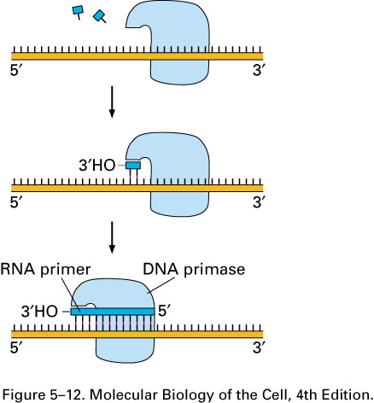
Once an origin has some length of SS DNA, the RNA creating enzyme primase, can creaet the first RNA primer for DNA polymerase to elongate.

Slide 37
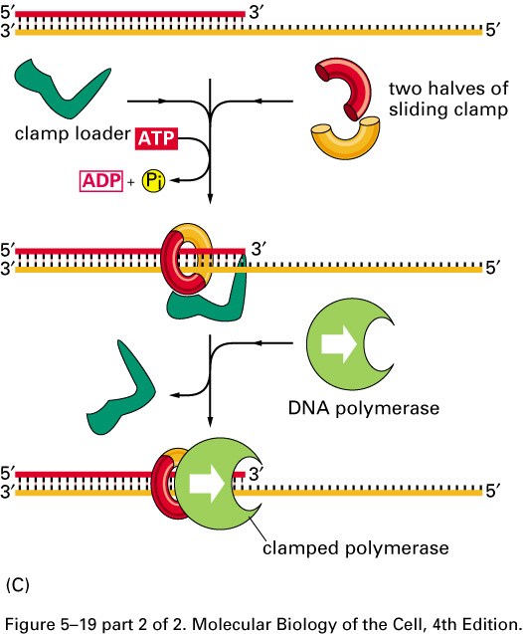
DNA polymerase requires several accessory proteins to assist its binding to the DNA template. A 2-protein “sliding clamp” assists in DNApol movement along the template.

Slide 38
Since both strands of the parent DNA molecule need complementary strands produced by DNA pol, 2 DNA pol complexes work simultaneously on each template strand.

Slide 39
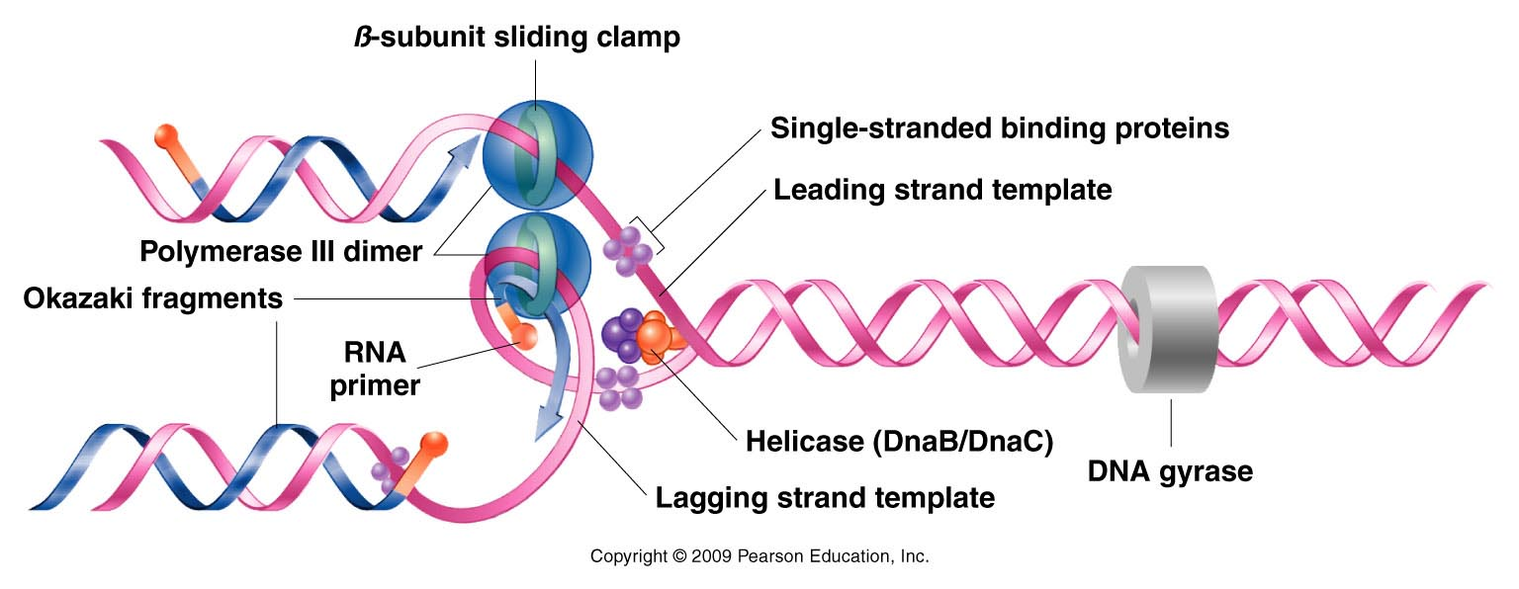
Know individual roles of replication fork proteins
Figure 11.13
Notes:
Figure 11-13 Summary of DNA synthesis at a single replication fork. Various enzymes and proteins essential to the process are shown.

Slide 40
dnaGyrase=bacterial topoisomerase
DNA topoisomerases work ahead of the replication enzymes. A great deal of physical stress is put on the helix as it unwinds. To avoid breaking the phosphodiester bonds of the parent molecule

Slide 41
Know individual roles of replication fork proteins
Figure 11.13
Notes:
Figure 11-13 Summary of DNA synthesis at a single replication fork. Various enzymes and proteins essential to the process are shown.

Slide 42
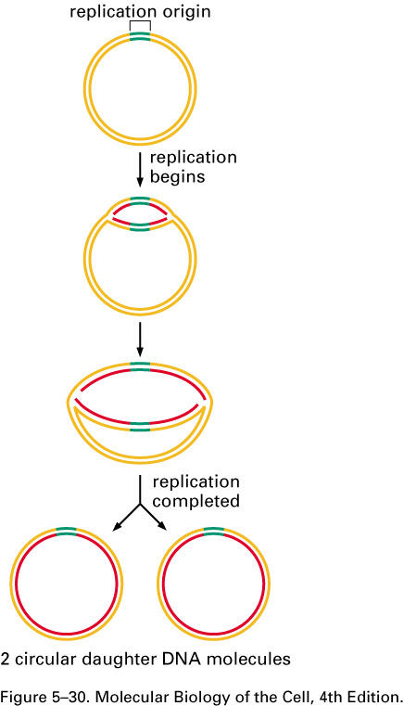
Replication bubbles and forks
The bubble provides 2
spots from which DNA pols
can work. Each spot is
known as a replication fork.

